Slide 1
LISTENING SKILLS
“If speaking is silver, then listening is gold.” -- Turkish Proverb

Slide 2
Objectives
Importance
Define the process of listening
Explain methods for improving listening skills
Explain barriers to effective listening

Slide 3
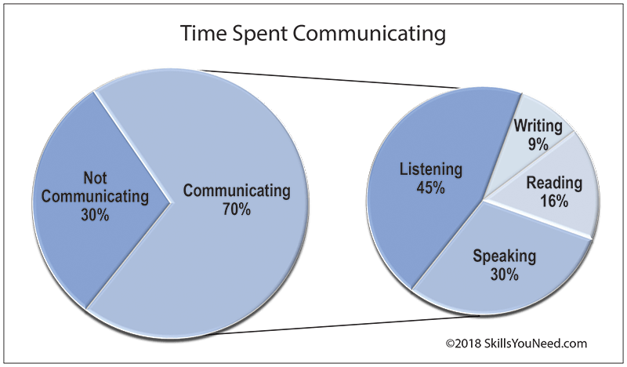
Based on the research of: Adler, R., Rosenfeld, L. and Proctor, R. (2001) Interplay: the process of interpersonal communicating (8th edn), Fort Worth, TX: Harcourt

Slide 4
What is it?
“The principle of listening, someone has said, is to develop a big ear rather than a big mouth” -- Howard G. Hendricks
Listening - the process of receiving, constructing meaning from, and responding to spoken and/or nonverbal messages.
Without proper listening skills it is difficult to communicate effectively with others.

Slide 5
Importance
To specifically focus on the messages being communicated, avoiding distractions and preconceptions.
To gain a full and accurate understanding into the speakers point of view and ideas.
To critically assess what is being said.
To observe the non-verbal signals accompanying what is being said to enhance understanding.
To show interest, concern and concentration.
To encourage the speaker to communicate fully, openly and honestly.
To develop an selflessness approach, putting the speaker first.
To arrive at a shared and agreed understanding and acceptance of both sides views.

Slide 6
Importance
Indicates a person’s ability to receive and interpret information in the communication process
Improves relationships – reduces misunderstanding
Improves our knowledge
Builds empathy
Prevents problems escalating
Saves time and energy
Can save money
Enhances leadership skills
Leads to better results

Slide 7
Jobs that require good LS
Sales
Negotiation
Coaching
Mentoring
Interviewing
Managing

Slide 8
Fallacies
Listening is not my problem
Listening and hearing are the same
Good readers are good listeners
Listening skills are difficult to learn

Slide 9
Types of Listening
Active listening
Empathetic listening
Critical listening
Appreciative listening

Slide 10
Process of Listening
Receiving/ Hearing
Attending
Understanding/Comprehending/interpreting
Analyzing
Responding
Remembering

Slide 11
TYPES/ MODES of LISTENING
Types
Characteristics
Superficial
Appreciative
Focused
Evaluative
Attentive
Empathetic
Listener has little/no awareness
Purpose is to derive pleasure
To get some specific information
Evaluate the message/commentary and develop a line of thought
Interactive and productive
Listening to speaker’s feelings, emotions and state of mind

Slide 12
Types- Andrew Wolvin and Carolyn Coakley
Discriminative Listening: distinguish between the verbal and non-verbal message
Comprehensive Listening : Listening to understand, for knowledge
Appreciative Listening: entertainment, appreciation -music, shows, informative and persuasive speeches
Empathetic: Listen and feel for others – Eulogy
Critical Listening: evaluate the message

Slide 13
Types
Discriminative listening: born with it – rely on tone of voice –verbal cues
Informational – to get information
Biased – selective listening
Sympathetic – listen to feelings and emotions – crucial to build deeper relations
Comprehensive – understand what is being said and to provide feedback
Empathetic or therapeutic – understand others’ pain
Critical – analyse complex information

Slide 14
Important Situations
Conversations
Interviews
Organizational activities
Negotiation
Group Discussion
Meetings

Slide 15
Factors Affecting Listening
Noise
Venue
Time
Status
Culture
State of mind
Ego
Pre-judgement
Language

Slide 16
Barriers
Environmental barriers
Physiological barriers
Psychological barriers
Selective Listening
Negative Listening Attitudes
Personal Reactions
Poor Motivation

Slide 17
Barriers to Effective Listening
Day dreaming
Mentally arguing with the speaker
Desire to talk
Lack of Interest
Negative reaction to the speaker’s appearance or delivery style

Slide 18
Developing Effective Listening
Stop Talking
Take notes
Identify with the speaker
Ask questions
Concentrate
Look interested
Control your emotions and temper
Avoid jumping to conclusions/ evaluations

Slide 19
Simple Listening Technique
Listen
Don’t interrupt
Let the speaker finish
Concentrate on what is being said and how it is being said
Make notes if this helps
Show the speaker that you are listening
Question
Check understanding
Summarise
Paraphrase what the speaker has just told you

Slide 20
Listening Skills - Tips
The SOLER approach ( Egan, 2002)
Squarely face the person
Open posture
Lean towards the person
Eye contact
Relax

Slide 21
Some useful phrases for active listening
Confirming:
Let me confirm...
Can I make sure I understand what you’ve said..?
Can I just check?
Summarising:
Can I summarise what you’ve said please?
I think you said...
Checking:
Is that right?
Have I understood you correctly?

Slide 22
Thank you for LISTENING!

